Slide 1
Telco Churn Project Which Factors Best Predict Customer Churn?
TEAM: KSHITIJ KAVISHWAR & Linda Zeng
Professor carlos Hoyos
Big Data Fall 2017

Slide 2


We recognize that at the heart of every Big Data problem there is a human problem
I. Introduction

Slide 3
Project Purpose
I. Introduction
Why Study Churn?
Churn is a business problem for telco and other industries.
Churn Factors
What makes a customer leave? Dissatisfaction of some kind.
Purpose of Project
We will identify the characteristics of a dissatisfied customer, and use found insights to incentivize loyalty.
Customer churn has a significant effect on the bottom line.

Slide 4
Describing the Data
I. Introduction
Select Variables of Interest | Data Type | Description
State | Categorical | A US State
Account Length | Numerical | In Days
International Plan | Categorical | Yes or No plan
Total day/eve/night charges | Numerical | Total charges for different parts of the day
Customer service calls | Numerical | Number of Calls
Churn | Categorical/Boolean | True or False
3333 observations of 21 variables
Churn is the predictive variable
All data types are of internal data sources
Notes:
state: categorical (a US domestic state)
account length: numerical (in days)
area code: numerical (shpuld be reclassified as categorical)
phone number: categorical
international plan: categorical voice mail plan: categorical number vmail messages: numerical total day minutes: numerical total day calls: numerical total day charge: numerical (in USD) total eve minutes: numerical total eve calls: numerical total eve charge: numerical (in USD) total night minutes: numerical total night calls: numerical total night charge: numerical (in USD) total intl minutes: numerical total intl calls: total number of international calls total intl charge: numerical (in USD) customer service calls: numerical churn: logical Booleanobservations of 21 variables

Slide 5
Data Sources
II. Data Collection
PRIMARY | AUXILIARY
https://www.kaggle.com/becksddf/churn-in-telecoms-dataset | https://www.statista.com/statistics/219825/total-churn-rate-of-atandt-wireless-customers/
https://www.ibm.com/communities/analytics/watson-analytics-blog/predictive-insights-in-the-telco-customer-churn-data-set/ | https://www.mckinsey.com/business-functions/digital-mckinsey/our-insights/how-telecom-companies-can-win-in-the-digital-revolution
Kaggle: dataset
IBM: dataset
Statista: trends
McKinsey: trends

Slide 6
Tools
II. Data Collection
IBM Data Science Experience
Python
Visualization
Tableau
Python

Slide 7
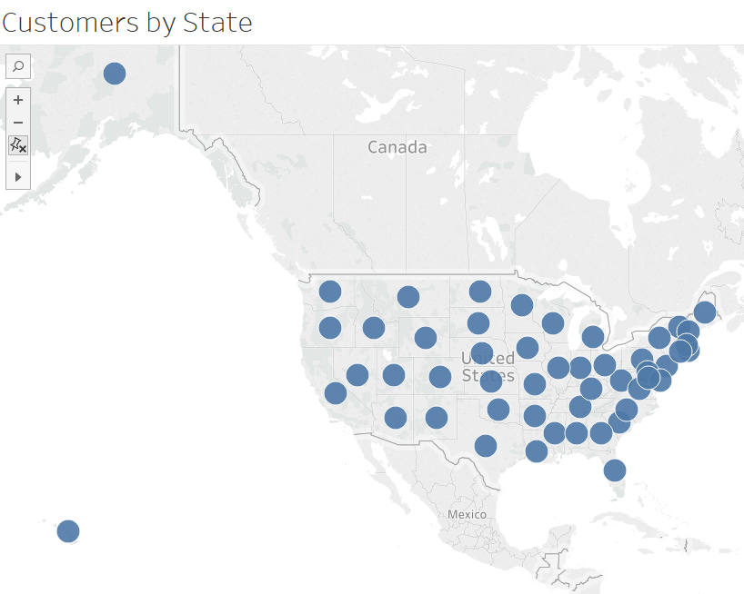
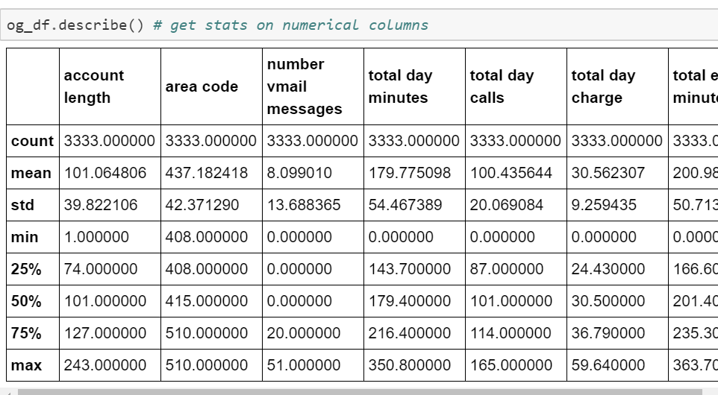
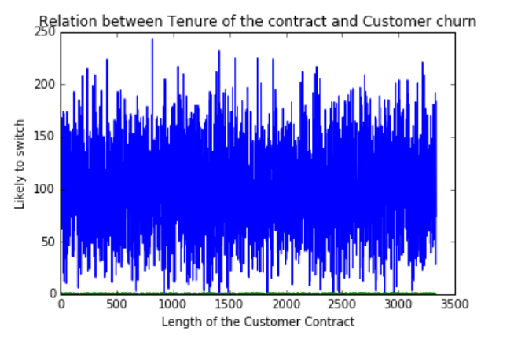
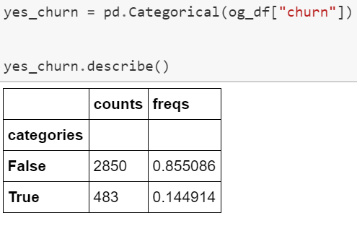
Visualizing the Data
III. Exploratory Data Analysis
First, descriptive statistics to get a sense of data
Customer base is all over the US

Slide 8
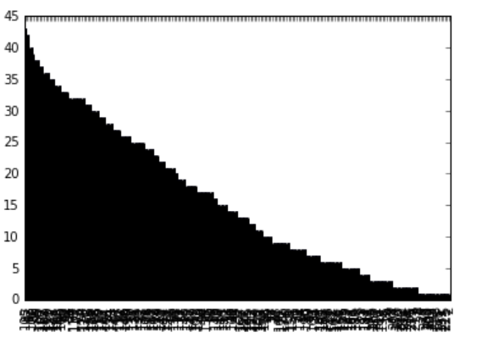
Hypothesis:
III. Exploratory Data Analysis
Account length vs Count of Account Length
account length + number of customer service calls = best churn predictors

Slide 9
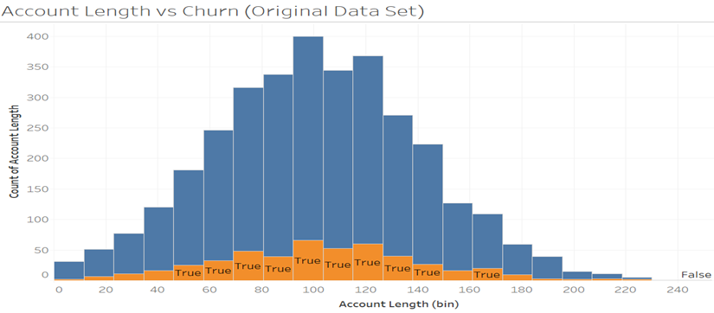
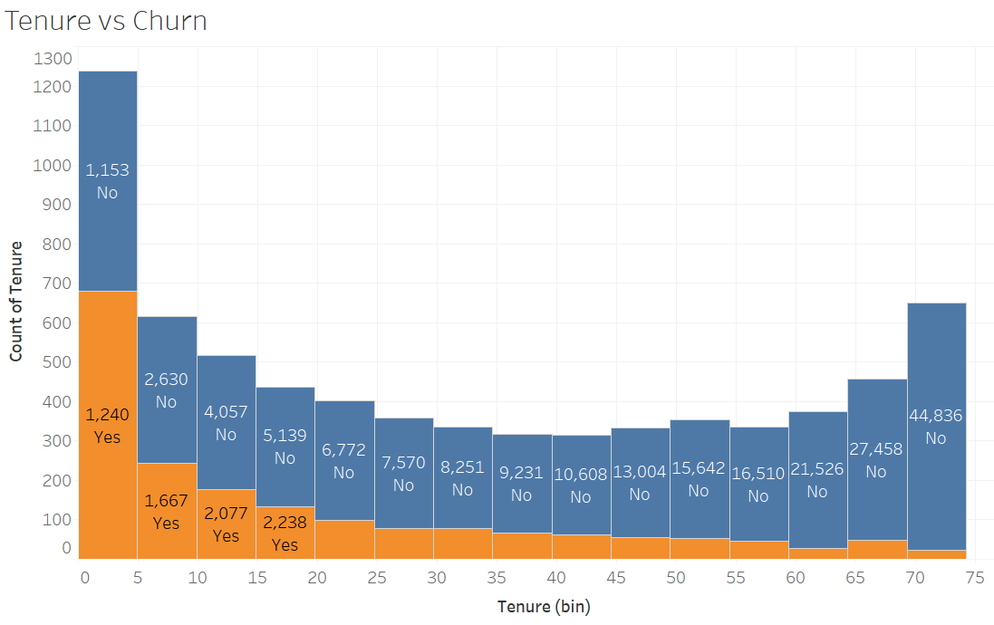
Visualizing the Data
III. Exploratory Data Analysis
Histogram of 1st dataset -symmetrical distribution
But 2nd dataset showed a positive skew, ie, tenure/ account length is inversely
proportional to churn
There must be another influential variable

Slide 10
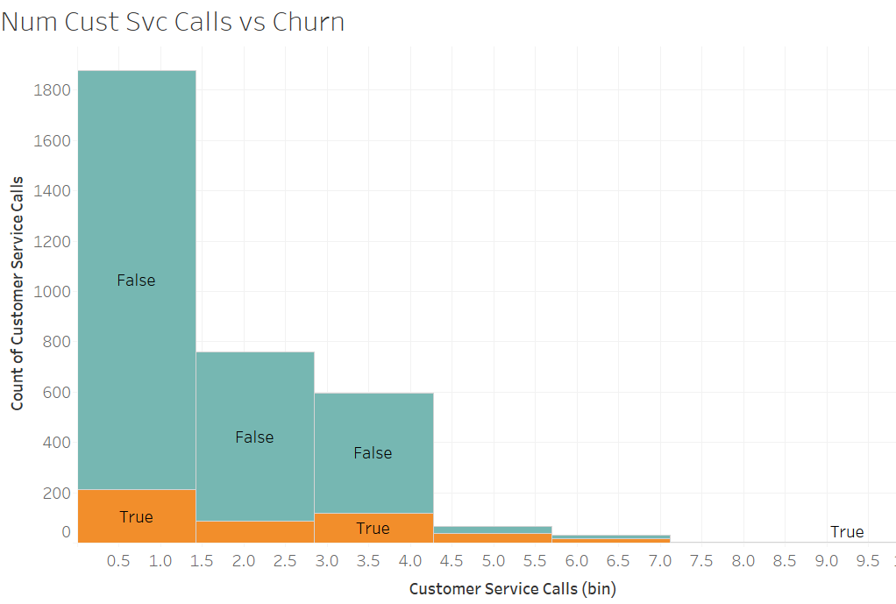
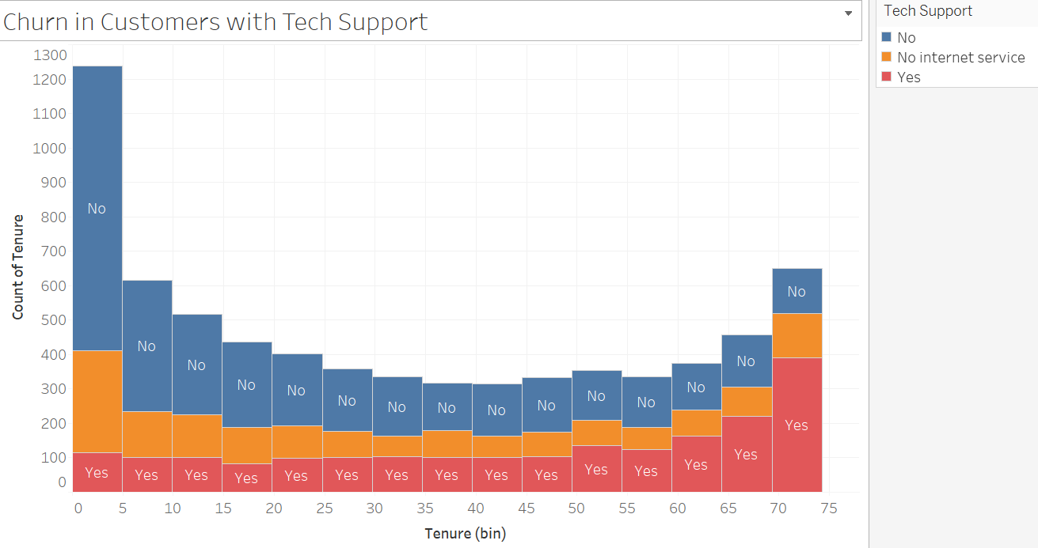
Visualizing the Data
III. Exploratory Data Analysis
1st dataset: number of customer service calls seem to better indicate churn
2nd dataset: similar results with a similar variable(Tech Support); but why the uptick at the tail?

Slide 11
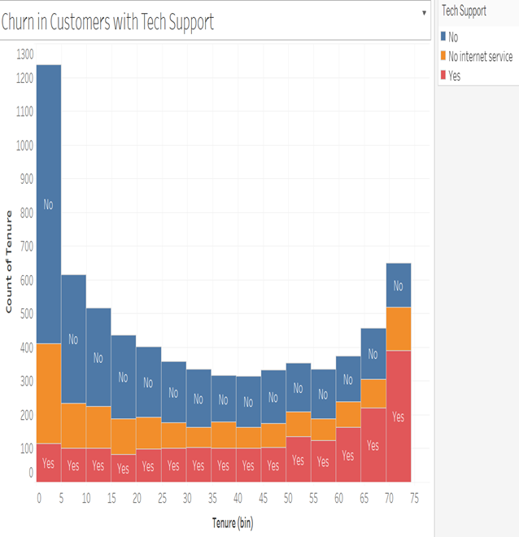
Visualizing the Data
III. Exploratory Data Analysis
Using visualized data, we are refining our hyphothesis. Why do long-term customers leave, even with tech support
Possible reasons:
Seniors-harder to adapt to technology
Loyalty didn’t pay
Frustration with Tech Support/Service
Future phases of project:
Use predictive models (logistic regression (for Churn variable), decision trees, random forest, KNN) to train and test churn indicators.

Slide 12
Insights
IV. Conclusion
Potential solutions for churn problem:
Release new consumer products based on demands/trends
Offer personalized incentives to stay
Early outreach to customers having high number of tech support calls
Seniors
Loyalty didn’t pay
Frustration with Tech Support

